Slide 1
Parametric
Equations
Twitter: @Owen134866
www.mathsfreeresourcelibrary.com

Slide 2


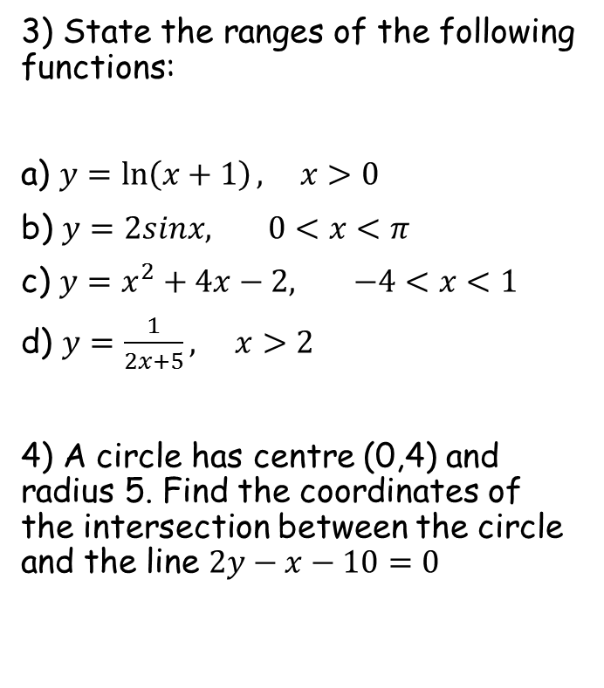


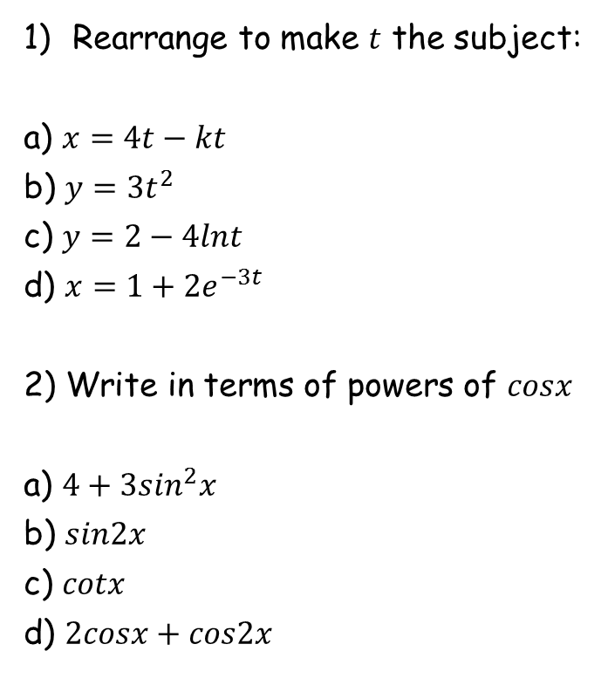









Prior Knowledge Check
Rearrange to make $t$ the subject:
a) $x=4t−kt$
b) $y=3t^{2}$
c) $y=2−4lnt$
d) $x=1+{2e}^{−3t}$
2) Write in terms of powers of $cosx$
a) $4+3\sin^{2}x$
b) $sin2x$
c) $cotx$
d) $2cosx+cos2x$
3) State the ranges of the following functions:
a) $y=\ln\left(x+1\right),$ $x>0$
b) $y=2sinx,$ $0<x<π$
c) $y=x^{2}+4x−2,$ $−4<x<1$
d) $y=\frac{1}{2x+5},$ $x>2$
4) A circle has centre (0,4) and radius 5. Find the coordinates of the intersection between the circle and the line $2y−x−10=0$
$$t=\frac{x}{4−k}$$
$$t=±\sqrt{\frac{y}{3}}$$
$$y>0$$
$$t=e^{\frac{2−y}{4}}$$
$$0<y<2$$
$$t=−\frac{1}{3}ln\left(\frac{x−1}{2}\right)$$
$$−6<y<3$$
$$0<y<1$$
$$7−3\cos^{2}x$$
$$2cosx\sqrt{1−\cos^{2}x}$$
$$\frac{cosx}{\sqrt{1−\cos^{2}x}}$$
$$2cosx+2\cos^{2}x−1$$
$(4,7)$ and $\left(−4.8,2.6\right)$

Slide 3
Teachings for
exercise 8A

Slide 4
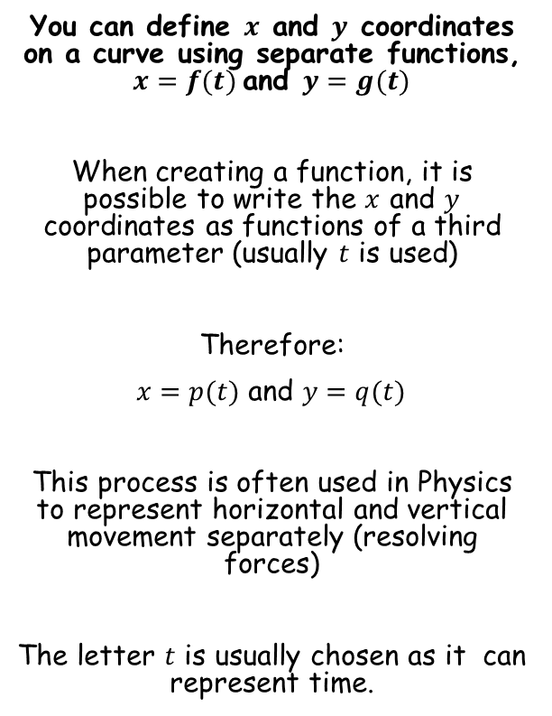
Parametric Equations
You can define $x$ and $y$ coordinates on a curve using separate functions, $x=f(t)$and $y=g(t)$
When creating a function, it is possible to write the $x$ and $y$ coordinates as functions of a third parameter (usually $t$ is used)
Therefore:
$x=p(t)$ and $y=q(t)$
This process is often used in Physics to represent horizontal and vertical movement separately (resolving forces)
The letter $t$ is usually chosen as it can represent time.
8A

Slide 5






Parametric Equations
You can define $x$ and $y$ coordinates on a curve using separate functions, $x=f(t)$and $y=g(t)$
Draw the graph of the function:
t
-3
-2
-1
0
1
2
3
x = 2t
-6
-4
-2
0
2
4
6
y = t²
9
4
1
0
1
4
9
10
$$x=2t$$
$$y=t^{2}$$
$$x=2t$$
$$y=t^{2}$$
$$−3≤t≤3$$
Work out the x and y co-ordinates to plot by substituting the t values
-10
10
-10
8A

Slide 6






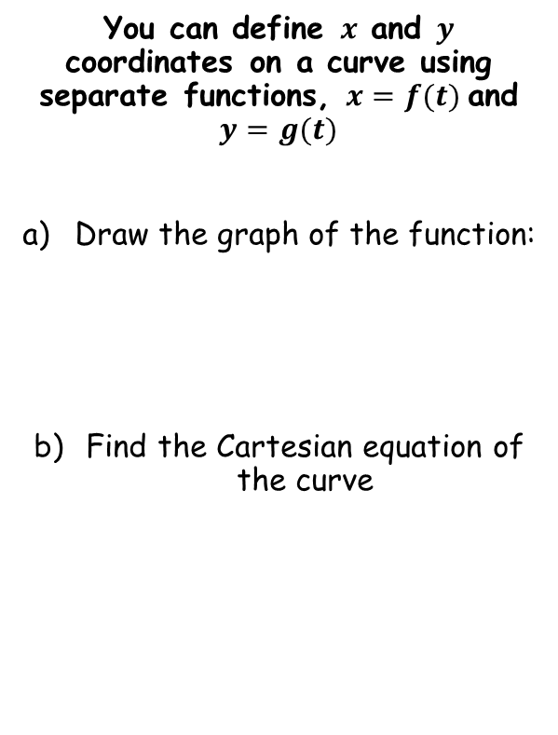
Parametric Equations
You can define $x$ and $y$ coordinates on a curve using separate functions, $x=f(t)$and $y=g(t)$
Draw the graph of the function:
Find the Cartesian equation of the curve
$$x=2t$$
Divide by 2
$$\frac{x}{2}=t$$
Now we can replace $t$ in the second equation…
$$x=2t$$
$$y=t^{2}$$
$$y=t^{2}$$
$$−3≤t≤3$$
Replace t with ^{x}/₂
$$y={\left(\frac{x}{2}\right)}^{2}$$
Simplify
$$y=\frac{x^{2}}{4}$$
Rewrite $t$ in terms of $x$, and then substitute it into the equation for $y$
8A

Slide 7



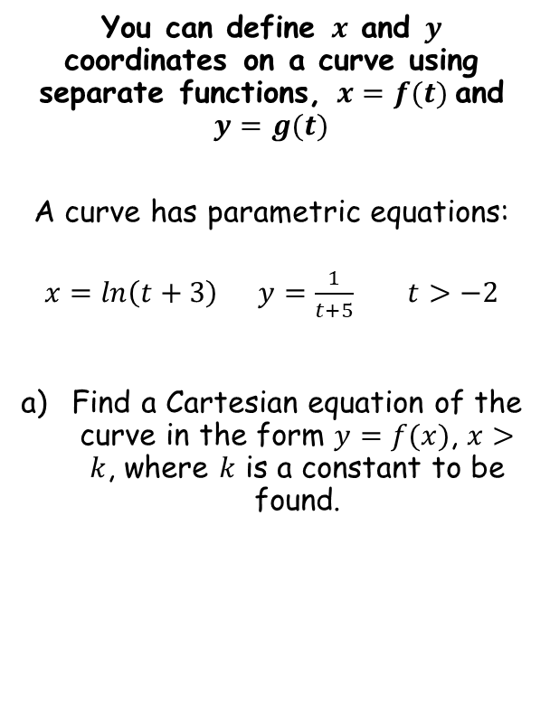





Parametric Equations
Rewrite $t$ in terms of $x$, and then substitute it into the equation for $y$
You can define $x$ and $y$ coordinates on a curve using separate functions, $x=f(t)$and $y=g(t)$
A curve has parametric equations:
$x=ln\left(t+3\right) y=\frac{1}{t+5}$ $t>−2$
Find a Cartesian equation of the curve in the form $y=f(x)$, $x>k$, where $k$ is a constant to be found.
$$x=ln\left(t+3\right)$$
Inverse logarithm
$$e^{x}=t+3$$
Subtract 3
$$e^{x}−3=t$$
$$y=\frac{1}{t+5}$$
Replace $t$ with the expression in $x$
$$y=\frac{1}{e^{x}−3+5}$$
Simplify
$$y=\frac{1}{e^{x}+2}$$
8A

Slide 8








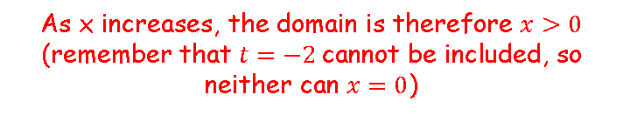




Parametric Equations
You can define $x$ and $y$ coordinates on a curve using separate functions, $x=f(t)$and $y=g(t)$
A curve has parametric equations:
$x=ln\left(t+3\right) y=\frac{1}{t+5}$ $t>−2$
Find a Cartesian equation of the curve in the form $y=f(x)$, $x>k$, where $k$ is a constant to be found.
$$x=ln\left(t+3\right)$$
We are given the limit of $t$ → Sub this in to find the limit of $x$
$$x=ln\left(−2+3\right)$$
Simplify
$$x=ln\left(1\right)$$
Calculate
$$x=0$$
Check what happens as $t$ increases…
$$x=ln\left(t+3\right)$$
Sub in $t=−1$
$$x=ln\left(−1+3\right)$$
Simplify
$$x=ln\left(2\right)$$
$$y=\frac{1}{e^{x}+2}$$
Calculate
$$x=0.693…$$
As x increases, the domain is therefore $x>0$
(remember that $t=−2$cannot be included, so neither can $x=0$)
8A

Slide 9



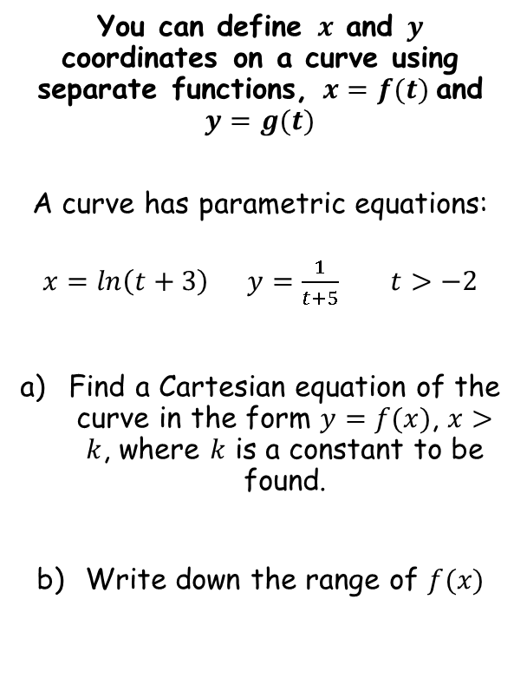






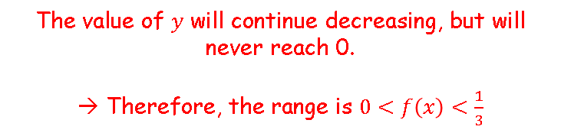
Parametric Equations
You can define $x$ and $y$ coordinates on a curve using separate functions, $x=f(t)$and $y=g(t)$
A curve has parametric equations:
$x=ln\left(t+3\right) y=\frac{1}{t+5}$ $t>−2$
Find a Cartesian equation of the curve in the form $y=f(x)$, $x>k$, where $k$ is a constant to be found.
Write down the range of $f(x)$
$$y=\frac{1}{t+5}$$
We are given the limit of $t$ → Sub this in to find the limit of $y$
$$y=\frac{1}{−2+5}$$
Calculate
$$y=\frac{1}{3}$$
Check what happens as $t$ increases…
$$y=\frac{1}{t+5}$$
Sub in $t=−1$
$$y=\frac{1}{−1+5}$$
Calculate
$$y=\frac{1}{e^{x}+2}$$
$$y=\frac{1}{4}$$
$$x>0$$
The value of $y$ will continue decreasing, but will never reach 0.
→ Therefore, the range is $0<f\left(x\right)<\frac{1}{3}$
8A

Slide 10
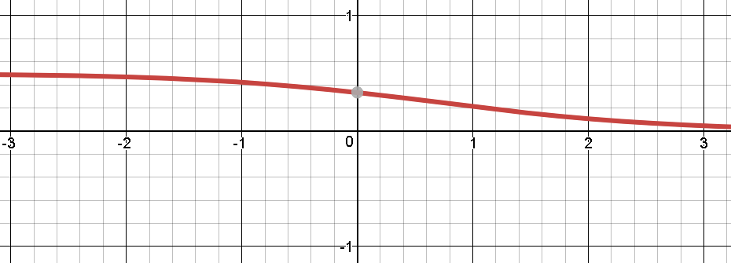



Parametric Equations
You can define $x$ and $y$ coordinates on a curve using separate functions, $x=f(t)$and $y=g(t)$
A curve has parametric equations:
$x=ln\left(t+3\right) y=\frac{1}{t+5}$ $t>−2$
Find a Cartesian equation of the curve in the form $y=f(x)$, $x>k$, where $k$ is a constant to be found.
Write down the range of $f(x)$
So essentially, when curves are expressed parametrically, you have separate functions for the domain and range…
$$y=\frac{1}{e^{x}+2}$$
The curve is shown above, although remember that we are only considering the part where $x>0$
$$y=\frac{1}{e^{x}+2}$$
$$x>0$$
$$0<f\left(x\right)<\frac{1}{3}$$
8A

Slide 11
Teachings for
exercise 8B

Slide 12



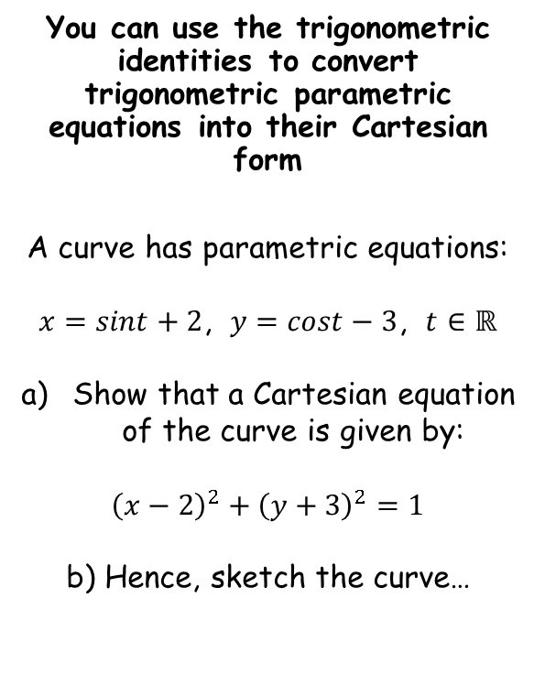



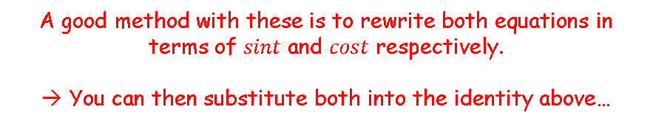

Parametric Equations
$$\sin^{2}t+\cos^{2}t≡1$$
A good method with these is to rewrite both equations in terms of $sint$ and $cost$ respectively.
→ You can then substitute both into the identity above…
You can use the trigonometric identities to convert trigonometric parametric equations into their Cartesian form
A curve has parametric equations:
$x=sint+2$, $y=cost−3$, $t∈ℝ$
Show that a Cartesian equation of the curve is given by:
$${\left(x−2\right)}^{2}+{\left(y+3\right)}^{2}=1$$
b) Hence, sketch the curve…
$$x=sint+2$$
Subtract 2
$$y=cost−3$$
Add 3
$$x−2=sint$$
$$y+3=cost$$
→ Sub these into the trig identity above…
$$\sin^{2}t+\cos^{2}t=1$$
Sub in expressions from above
$${\left(x−2\right)}^{2}+{\left(y+3\right)}^{2}=1$$
8B

Slide 13



Parametric Equations
$$\sin^{2}t+\cos^{2}t≡1$$
$$y$$
You can use the trigonometric identities to convert trigonometric parametric equations into their Cartesian form
A curve has parametric equations:
$x=sint+2$, $y=cost−3$, $t∈ℝ$
Show that a Cartesian equation of the curve is given by:
$${\left(x−2\right)}^{2}+{\left(y+3\right)}^{2}=1$$
b) Hence, sketch the curve…
$$x$$
$${\left(x−2\right)}^{2}+{\left(y+3\right)}^{2}=1$$
→ So the equation is a circle, centre (2,-3), with radius 1
8B

Slide 14






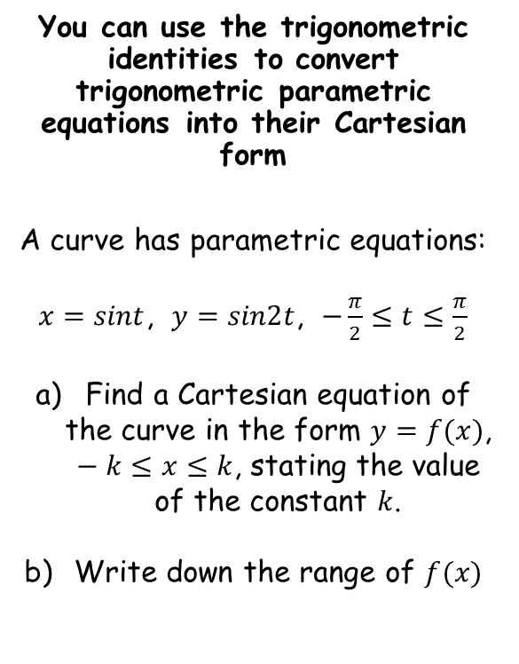








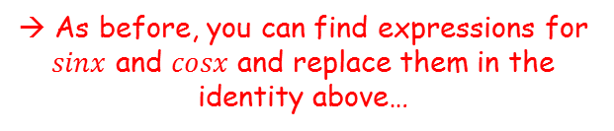


Parametric Equations
$$\sin^{2}t+\cos^{2}t≡1$$
$$sin2t=2sintcost$$
You can use the trigonometric identities to convert trigonometric parametric equations into their Cartesian form
A curve has parametric equations:
$x=sint$, $y=sin2t$, $−\frac{π}{2}≤t≤\frac{π}{2}$
Find a Cartesian equation of the curve in the form $y=f(x)$, $−k≤x≤k$, stating the value of the constant $k$.
Write down the range of $f(x)$
$$x=sint$$
$$y=sin2t$$
Use double-angle formula
$$y=2sintcost$$
Replace $sint$
$$y=2xcost$$
$$\frac{y}{2x}=cost$$
Divide by $2x$
$$\sin^{2}t+\cos^{2}t=1$$
Replace using the expressions above
$$x^{2}+{\left(\frac{y}{2x}\right)}^{2}=1$$
Square the fraction
$$x^{2}+\frac{y^{2}}{{4x}^{2}}=1$$
Multiply all by ${4x}^{2}$
$${4x}^{4}+y^{2}={4x}^{2}$$
Subtract ${4x}^{4}$
→ As before, you can find expressions for $sinx$ and $cosx$ and replace them in the identity above…
$$y^{2}={4x}^{2}−{4x}^{4}$$
Factorise right side
$$y^{2}={4x}^{2}\left(1−x^{2}\right)$$
8B

Slide 15



Parametric Equations
$$\sin^{2}t+\cos^{2}t≡1$$
$$sin2t=2sintcost$$
You can use the trigonometric identities to convert trigonometric parametric equations into their Cartesian form
A curve has parametric equations:
$x=sint$, $y=sin2t$, $−\frac{π}{2}≤t≤\frac{π}{2}$
Find a Cartesian equation of the curve in the form $y=f(x)$, $−k≤x≤k$, stating the value of the constant $k$.
Write down the range of $f(x)$
$$y^{2}={4x}^{2}\left(1−x^{2}\right)$$
Square root both sides
$$y=2x\sqrt{\left(1−x^{2}\right) }$$
Check that the right side would square and give the correct expression which we had previously!
$$y=2x\sqrt{\left(1−x^{2}\right) }$$
→ As before, you can find expressions for $sinx$ and $cosx$ and replace them in the identity above…
8B

Slide 16








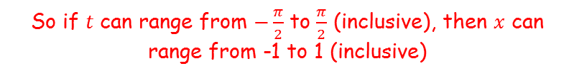


Parametric Equations
$$\sin^{2}t+\cos^{2}t≡1$$
$$sin2t=2sintcost$$
You can use the trigonometric identities to convert trigonometric parametric equations into their Cartesian form
A curve has parametric equations:
$x=sint$, $y=sin2t$, $−\frac{π}{2}≤t≤\frac{π}{2}$
Find a Cartesian equation of the curve in the form $y=f(x)$, $−k≤x≤k$, stating the value of the constant $k$.
Write down the range of $f(x)$
To find the domain, consider what values $x$ can take, for the given values of $t$…
$$x=sint$$
$$−\frac{π}{2}≤t≤\frac{π}{2}$$
$$x$$
1
$$x=sint$$
-π
$$t$$
-^{π}/₂
^{π}/₂
π
-1
$$t=−\frac{π}{2}$$
$$t=\frac{π}{2}$$
So if $t$ can range from $−\frac{π}{2}$ to $\frac{π}{2}$ (inclusive), then $x$ can range from -1 to 1 (inclusive)
$$y=2x\sqrt{\left(1−x^{2}\right) }$$
$$−1≤x≤1$$
$$−1≤x≤1$$
→ As before, you can find expressions for $sinx$ and $cosx$ and replace them in the identity above…
8B

Slide 17








Parametric Equations
$$\sin^{2}t+\cos^{2}t≡1$$
$$sin2t=2sintcost$$
You can use the trigonometric identities to convert trigonometric parametric equations into their Cartesian form
A curve has parametric equations:
$x=sint$, $y=sin2t$, $−\frac{π}{2}≤t≤\frac{π}{2}$
Find a Cartesian equation of the curve in the form $y=f(x)$, $−k≤x≤k$, stating the value of the constant $k$.
Write down the range of $f(x)$
To find the range, consider what values $y$ can take, for the given values of $t$…
$$y=sin2t$$
$$−\frac{π}{2}≤t≤\frac{π}{2}$$
$$y$$
1
$$y=sin2t$$
-π
$$t$$
-^{π}/₂
^{π}/₂
π
-1
$$t=−\frac{π}{2}$$
$$t=\frac{π}{2}$$
So if $t$ can range from $−\frac{π}{2}$ to $\frac{π}{2}$ (inclusive), then $y$ can range from -1 to 1 (inclusive)
$$y=2x\sqrt{\left(1−x^{2}\right) }$$
$$−1≤x≤1$$
$$−1≤y≤1$$
$$−1≤f(x)≤1$$
8B

Slide 18
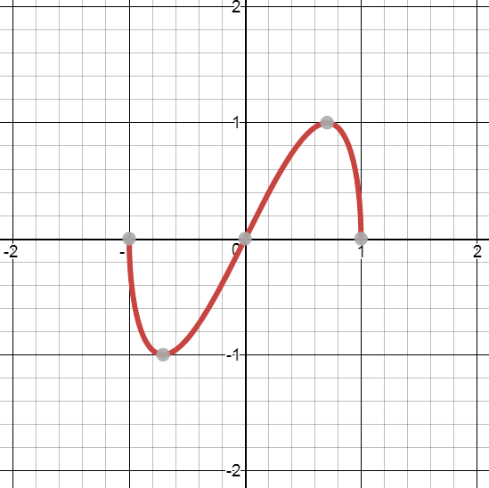

Parametric Equations
$$\sin^{2}t+\cos^{2}t≡1$$
$$sin2t=2sintcost$$
You can use the trigonometric identities to convert trigonometric parametric equations into their Cartesian form
A curve has parametric equations:
$x=sint$, $y=sin2t$, $−\frac{π}{2}≤t≤\frac{π}{2}$
Find a Cartesian equation of the curve in the form $y=f(x)$, $−k≤x≤k$, stating the value of the constant $k$.
Write down the range of $f(x)$
$$y=2x\sqrt{1−x^{2}}$$
$$y=2x\sqrt{\left(1−x^{2}\right) }$$
$$−1≤x≤1$$
$$−1≤f(x)≤1$$
8B

Slide 19


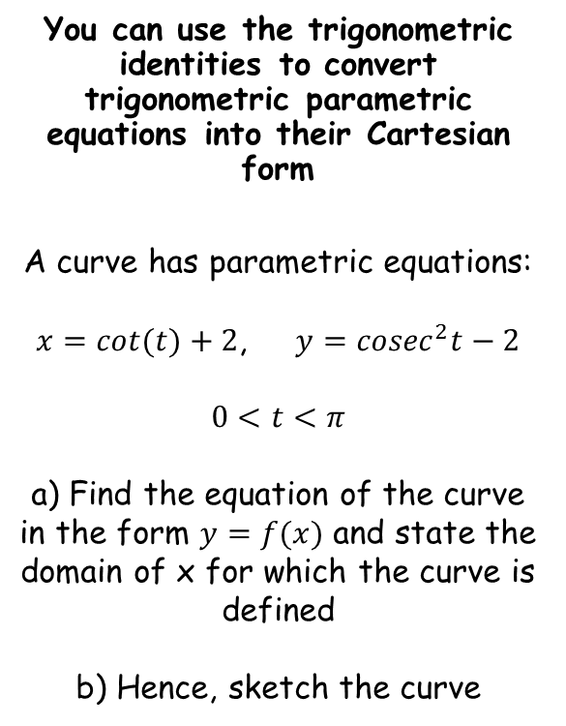







Parametric Equations
$$\sin^{2}t+\cos^{2}t≡1$$
$$sin2t=2sintcost$$
You can use the trigonometric identities to convert trigonometric parametric equations into their Cartesian form
A curve has parametric equations:
$x=cot⁡(t)+2$, $y={cosec}^{2}t−2$
$$0<t<π$$
a) Find the equation of the curve in the form $y=f(x)$ and state the domain of x for which the curve is defined
b) Hence, sketch the curve
→ Start by rearranging the parametric equations, as in the previous examples…
$$x=cot⁡(t)+2$$
Subtract 2
$$y={cosec}^{2}t−2$$
Add 2
$$x−2=cot⁡(t)$$
$$y+2={cosec}^{2}t$$
→ Remember that you can use the identity above to remind yourself of those involving cot and cosec instead…
$$1+\cot^{2}t={cosec}^{2}t$$
Replace using the expressions above
$$1+{\left(x−2\right)}^{2}=y+2$$
Subtract 2
$$−1+{\left(x−2\right)}^{2}=y$$
Expand bracket and simplify
$$x^{2}−4x+3=y$$
$$y=x^{2}−4x+3$$
8B

Slide 20












Parametric Equations
$$\sin^{2}t+\cos^{2}t≡1$$
$$sin2t=2sintcost$$
You can use the trigonometric identities to convert trigonometric parametric equations into their Cartesian form
A curve has parametric equations:
$x=cot⁡(t)+2$, $y={cosec}^{2}t−2$
$$0<t<π$$
a) Find the equation of the curve in the form $y=f(x)$ and state the domain of x for which the curve is defined
b) Hence, sketch the curve
To find the values of $x$ for which the curve is defined, use the limits of $t$ in the function for $x$
$$x=cot\left(t\right)+2$$
$$0<t<π$$
$$x$$
$$0$$
$$t$$
$$\frac{π}{2}$$
$$π$$
$$y=cot(t)+2$$
As there are asymptotes at $t=0$and $t=π$, between these, $x$ can take any value
$$x∈ℝ$$
$$y=x^{2}−4x+3$$
$$x∈ℝ$$
8B

Slide 21




Parametric Equations
$$\sin^{2}t+\cos^{2}t≡1$$
$$sin2t=2sintcost$$
$$y$$
$$y=x^{2}−4x+3$$
You can use the trigonometric identities to convert trigonometric parametric equations into their Cartesian form
A curve has parametric equations:
$x=cot⁡(t)+2$, $y={cosec}^{2}t−2$
$$0<t<π$$
a) Find the equation of the curve in the form $y=f(x)$ and state the domain of x for which the curve is defined
b) Hence, sketch the curve
$$3$$
$$1$$
$$3$$
$$x$$
$$y=x^{2}−4x+3$$
$$x∈ℝ$$
→ Find the roots and y-intercept
8B

Slide 22
Teachings for
exercise 8C

Slide 23






























Parametric Equations
You need to be able to plot graphs of parametric equations
Sketch the graphs below on two separate axes:
$x=3cost+4$, $y=2sint$ $0≤t≤2π$
$$x$$
$$y$$
$$6$$
$$6$$
$$4$$
$$x=3cost+4$$
$$4$$
$$2$$
$$2$$
$$y=2sint$$
$$t$$
$$t$$
$$−2$$
$$\frac{π}{4}$$
$$\frac{π}{2}$$
$$\frac{3π}{4}$$
$$π$$
$$\frac{5π}{4}$$
$$\frac{3π}{2}$$
$$\frac{7π}{4}$$
$$2π$$
$$−2$$
$$\frac{π}{4}$$
$$\frac{π}{2}$$
$$\frac{3π}{4}$$
$$π$$
$$\frac{5π}{4}$$
$$\frac{3π}{2}$$
$$\frac{7π}{4}$$
$$2π$$
$$−4$$
$$−4$$
$$−6$$
$$−6$$
8C

Slide 24









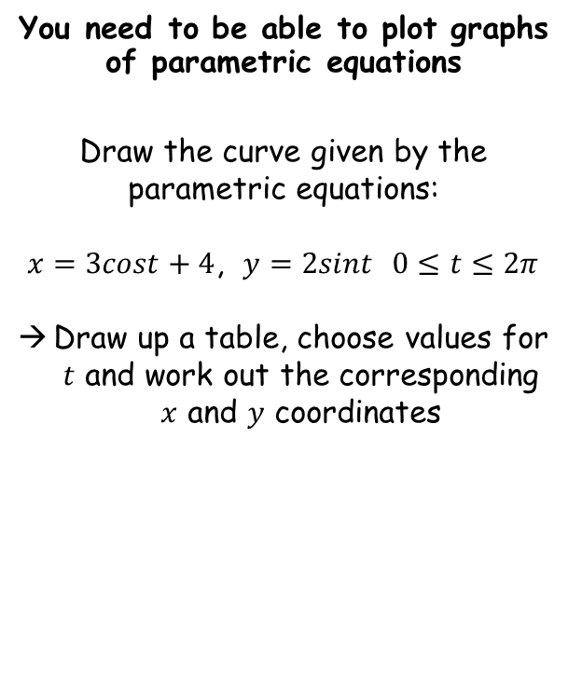


























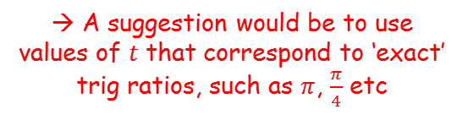








Parametric Equations
You need to be able to plot graphs of parametric equations
Draw the curve given by the parametric equations:
$x=3cost+4$, $y=2sint$ $0≤t≤2π$
Draw up a table, choose values for $t$ and work out the corresponding $x$ and $y$ coordinates
$$t$$
$$0$$
$$\frac{π}{4}$$
$$\frac{π}{2}$$
$$\frac{3π}{4}$$
$$π$$
$$\frac{5π}{4}$$
$$\frac{3π}{2}$$
$$\frac{7π}{4}$$
$$2π$$
$$x$$
$$7$$
$$6.12$$
$$4$$
$$1.87$$
$$1$$
$$1.87$$
$$4$$
$$6.12$$
$$7$$
$$y$$
$$0$$
$$1.41$$
$$2$$
$$1.41$$
$$0$$
$$−1.41$$
$$−2$$
$$−1.41$$
$$0$$
$$y$$
$$2$$
$$x=3cost+4$$
$$1$$
$$y=2sint$$
→ A suggestion would be to use values of $t$ that correspond to ‘exact’ trig ratios, such as $π$, $\frac{π}{4}$ etc
$$x$$
$$1$$
$$2$$
$$3$$
$$4$$
$$5$$
$$6$$
$$7$$
$$−1$$
$$−2$$
8C

Slide 25































Parametric Equations
Compare the separate graphs for $x$ and $y$ with the combined curve – what do you notice?
$$x$$
$$y$$
$$6$$
$$6$$
$$4$$
$$x=3cost+4$$
$$4$$
$$2$$
$$2$$
$$y=2sint$$
$$t$$
$$t$$
$$−2$$
$$\frac{π}{4}$$
$$\frac{π}{2}$$
$$\frac{3π}{4}$$
$$π$$
$$\frac{5π}{4}$$
$$\frac{3π}{2}$$
$$\frac{7π}{4}$$
$$2π$$
$$−2$$
$$\frac{π}{4}$$
$$\frac{π}{2}$$
$$\frac{3π}{4}$$
$$π$$
$$\frac{5π}{4}$$
$$\frac{3π}{2}$$
$$\frac{7π}{4}$$
$$2π$$
$$−4$$
$$−4$$
$$−6$$
$$−6$$
$$y$$
$$2$$
$$x=3cost+4$$
$$1$$
$$y=2sint$$
$$x$$
$$1$$
$$2$$
$$3$$
$$4$$
$$5$$
$$6$$
$$7$$
$$−1$$
$$−2$$
8C

Slide 26
Teachings for
exercise 8D

Slide 27


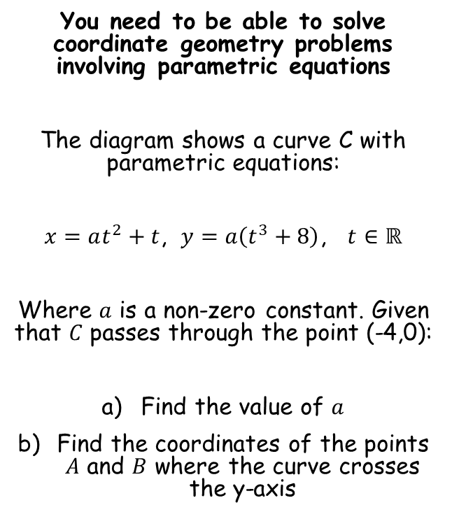




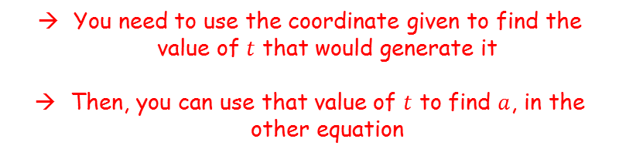
Parametric Equations
$$x=at^{2}+t$$
$$y$$
You need to be able to solve coordinate geometry problems involving parametric equations
The diagram shows a curve C with parametric equations:
$x=at^{2}+t$, $y=a\left(t^{3}+8\right)$, $t∈ℝ$
Where $a$ is a non-zero constant. Given that $C$ passes through the point (-4,0):
Find the value of $a$
Find the coordinates of the points $A$ and $B$ where the curve crosses the y-axis
$$y=a\left(t^{3}+8\right)$$
$$O$$
$$x$$
$$−4$$
$$A$$
$$B$$
You need to use the coordinate given to find the value of $t$ that would generate it
Then, you can use that value of $t$ to find $a$, in the other equation
8D

Slide 28

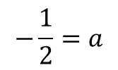











Parametric Equations
You need to be able to solve coordinate geometry problems involving parametric equations
The diagram shows a curve C with parametric equations:
$x=at^{2}+t$, $y=a\left(t^{3}+8\right)$, $t∈ℝ$
Where $a$ is a non-zero constant. Given that $C$ passes through the point (-4,0):
Find the value of $a$
Find the coordinates of the points $A$ and $B$ where the curve crosses the y-axis
$$y=a\left(t^{3}+8\right)$$
We have a coordinate where the $y$ part is 0
$$0=a\left(t^{3}+8\right)$$
Since $a$ cannot be 0, the bracket must be
$$0=t^{3}+8$$
Subtract 8
$$−8=t^{3}$$
Cube root
$$−2=t$$
So this value of t will give us the y-coordinate of 0.
→ We also know that it will give an x-coordinate of -4 when substituted into the other equation
$$x=at^{2}+t$$
Sub in $t=−2$and $x=−4$
$$−4=a{\left(−2\right)}^{2}+(−2)$$
Simplify
$$−4=4a−2$$
$$−\frac{1}{2}=a$$
Solve for $a$
8D

Slide 29



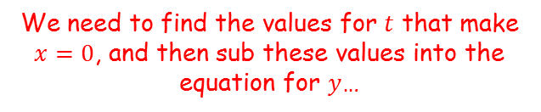



Parametric Equations
$$x=at^{2}+t$$
$$y$$
You need to be able to solve coordinate geometry problems involving parametric equations
The diagram shows a curve C with parametric equations:
$x=at^{2}+t$, $y=a\left(t^{3}+8\right)$, $t∈ℝ$
Where $a$ is a non-zero constant. Given that $C$ passes through the point (-4,0):
Find the value of $a$
Find the coordinates of the points $A$ and $B$ where the curve crosses the y-axis
$$y=a\left(t^{3}+8\right)$$
$$O$$
$$x$$
$$−4$$
$$A$$
$$B$$
$$x=at^{2}+t$$
We know that $a=−\frac{1}{2}$, and on the y-axis, $x=0$
$$a=−\frac{1}{2}$$
$$0=−\frac{1}{2}t^{2}+t$$
$$0=t\left(−\frac{1}{2}t+1\right)$$
Factorise
Solve for t
We need to find the values for $t$ that make $x=0$, and then sub these values into the equation for $y$…
$t=0$ or $t=2$
8D

Slide 30







Parametric Equations
$$x=at^{2}+t$$
$$y$$
You need to be able to solve coordinate geometry problems involving parametric equations
The diagram shows a curve C with parametric equations:
$x=at^{2}+t$, $y=a\left(t^{3}+8\right)$, $t∈ℝ$
Where $a$ is a non-zero constant. Given that $C$ passes through the point (-4,0):
Find the value of $a$
Find the coordinates of the points $A$ and $B$ where the curve crosses the y-axis
$$y=a\left(t^{3}+8\right)$$
$$O$$
$$x$$
$$−4$$
$$A$$
$$B$$
$t=0$ or $t=2$
$$a=−\frac{1}{2}$$
$$y=a\left(t^{3}+8\right)$$
$a=−\frac{1}{2}$, $t=0$
$a=−\frac{1}{2}$, $t=2$
$$y=−\frac{1}{2}\left(0+8\right)$$
$$y=−\frac{1}{2}\left(8+8\right)$$
We need to find the values for $t$ that make $x=0$, and then sub these values into the equation for $y$…
$$y=−4$$
$$y=−8$$
8D

Slide 31
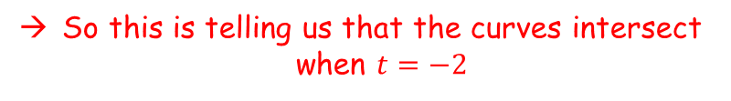

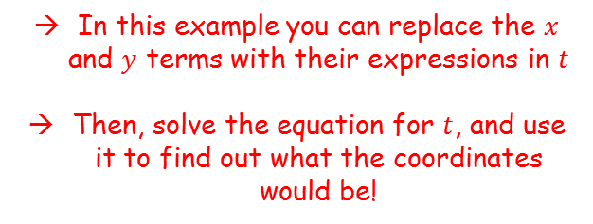


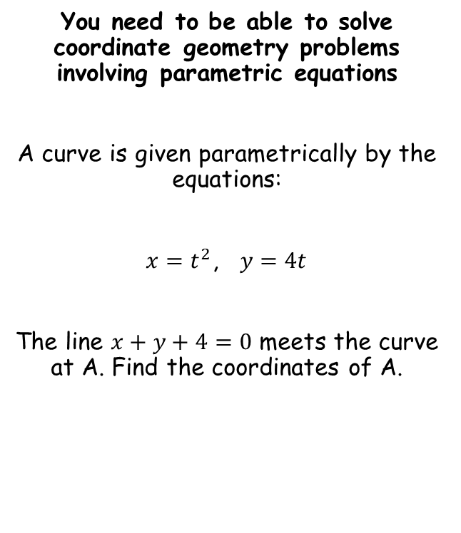









Parametric Equations
You need to be able to solve coordinate geometry problems involving parametric equations
A curve is given parametrically by the equations:
$x=t^{2}$, $y=4t$
The line $x+y+4=0$ meets the curve at A. Find the coordinates of A.
$x+y+4=0$
Sub in values
$t^{2}+4t+4=0$
Factorise
$${\left(t+2\right)}^{2}=0$$
Solve
$$t=−2$$
So this is telling us that the curves intersect when $t=−2$
$$x=t^{2}$$
$$y=4t$$
Sub in $t=−2$
Sub in $t=−2$
$$x={(−2)}^{2}$$
$$y=4(−2)$$
Work out
Work out
In this example you can replace the $x$ and $y$ terms with their expressions in $t$
Then, solve the equation for $t$, and use it to find out what the coordinates would be!
$$x=4$$
$$y=−8$$
So the curves intersect at (4,-8)
8D

Slide 32
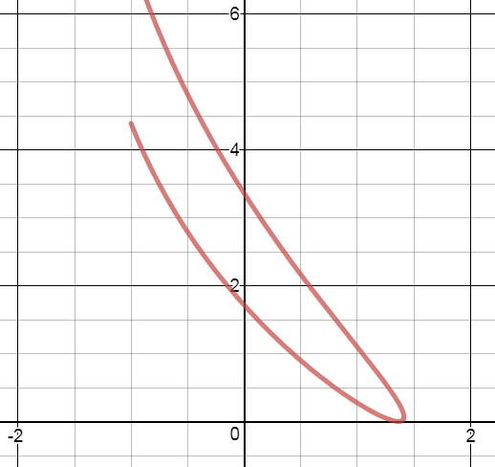

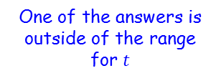


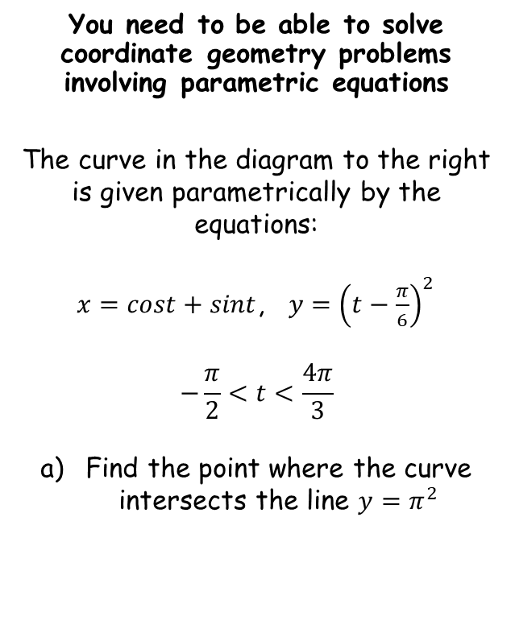






Parametric Equations
$$x=cost+sint$$
$$y={\left(t−\frac{π}{6}\right)}^{2}$$
You need to be able to solve coordinate geometry problems involving parametric equations
The curve in the diagram to the right is given parametrically by the equations:
$x=cost+sint$, $y={\left(t−\frac{π}{6}\right)}^{2}$
$$−\frac{π}{2}<t<\frac{4π}{3}$$
Find the point where the curve intersects the line $y=π^{2}$
$$y={\left(t−\frac{π}{6}\right)}^{2}$$
The intersection will be where $y=π^{2}$
$$π^{2}={\left(t−\frac{π}{6}\right)}^{2}$$
Root both sides
$$±π=t−\frac{π}{6}$$
Add $\frac{π}{6}$
$$\frac{π}{6}±π=t$$
One of the answers is outside of the range for $t$
Calculate answers
$t=−\frac{5π}{6}$ or $\frac{7π}{6}$
8D

Slide 33






Parametric Equations
$$x=cost+sint$$
$$y={\left(t−\frac{π}{6}\right)}^{2}$$
You need to be able to solve coordinate geometry problems involving parametric equations
The curve in the diagram to the right is given parametrically by the equations:
$x=cost+sint$, $y={\left(t−\frac{π}{6}\right)}^{2}$
$$−\frac{π}{2}<t<\frac{4π}{3}$$
Find the point where the curve intersects the line $y=π^{2}$
$t=$ $\frac{7π}{6}$
$$x=cost+sint$$
Sub in $t=\frac{7π}{6}$
$$x=cos\left(\frac{7π}{6}\right)+sin\left(\frac{7π}{6}\right)$$
Calculate
$$x=−\frac{1+\sqrt{3}}{2}$$
So the full coordinates of the intersection are: $\left(−\frac{1+\sqrt{3}}{2},π^{2}\right)$
8D

Slide 34





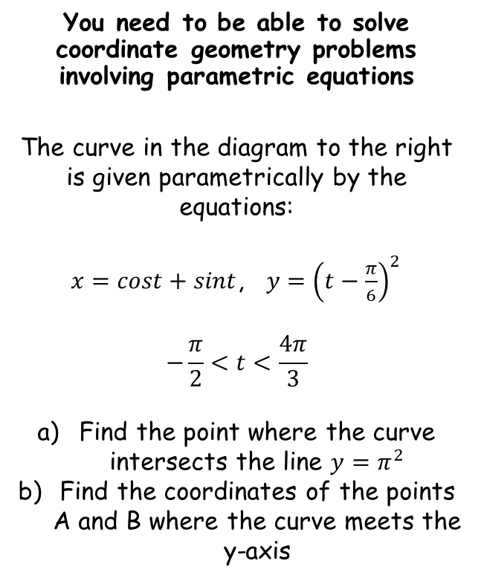







Parametric Equations
$$x=cost+sint$$
$$y={\left(t−\frac{π}{6}\right)}^{2}$$
You need to be able to solve coordinate geometry problems involving parametric equations
The curve in the diagram to the right is given parametrically by the equations:
$x=cost+sint$, $y={\left(t−\frac{π}{6}\right)}^{2}$
$$−\frac{π}{2}<t<\frac{4π}{3}$$
Find the point where the curve intersects the line $y=π^{2}$
Find the coordinates of the points A and B where the curve meets the y-axis
$$x=cost+sint$$
On the y-axis, $x=0$
$$0=cost+sint$$
$$\left(−\frac{1+\sqrt{3}}{2},π^{2}\right)$$
Subtract $cost$
$$−cost=sint$$
Divide by $cost$ (which in this case cannot be 0 since then $sint$ would also have to be 0 – not possible for the same value of $t$)
$$−1=tant$$
Calculate, and remember to find other values within the allowed range for $t$…
$$t=−\frac{π}{4}$$
$$, \frac{3π}{4}$$
These are the values of $t$ that would make the x-coordinate 0. Now we need to find the values of y we would get from them
8D

Slide 35


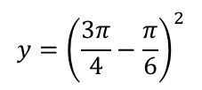








Parametric Equations
$$x=cost+sint$$
$$y={\left(t−\frac{π}{6}\right)}^{2}$$
You need to be able to solve coordinate geometry problems involving parametric equations
The curve in the diagram to the right is given parametrically by the equations:
$x=cost+sint$, $y={\left(t−\frac{π}{6}\right)}^{2}$
$$−\frac{π}{2}<t<\frac{4π}{3}$$
Find the point where the curve intersects the line $y=π^{2}$
Find the coordinates of the points A and B where the curve meets the y-axis
$$t=−\frac{π}{4}$$
$$, \frac{3π}{4}$$
$$\left(−\frac{1+\sqrt{3}}{2},π^{2}\right)$$
$$y={\left(t−\frac{π}{6}\right)}^{2}$$
$$t=−\frac{π}{4}$$
$$t=\frac{3π}{4}$$
$$y={\left(−\frac{π}{4}−\frac{π}{6}\right)}^{2}$$
$$y={\left(\frac{3π}{4}−\frac{π}{6}\right)}^{2}$$
$$\left(0,\frac{25π^{2}}{144}\right)$$
$$\left(0,\frac{49π^{2}}{144}\right)$$
$$y=\frac{25π^{2}}{144}$$
$$y=\frac{49π^{2}}{144}$$
8D

Slide 36
Teachings for
exercise 8E

Slide 37



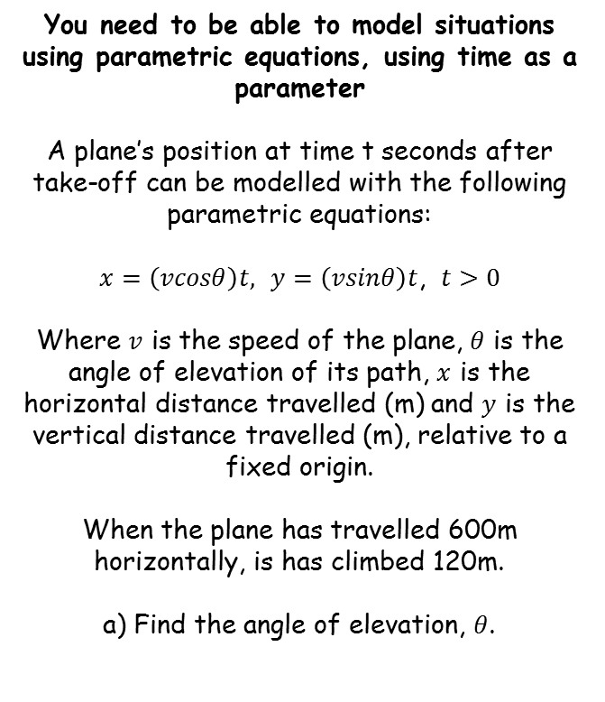




Parametric Equations
You need to be able to model situations using parametric equations, using time as a parameter
A plane’s position at time t seconds after take-off can be modelled with the following parametric equations:
$x=\left(vcosθ\right)t,$ $y=\left(vsinθ\right)t$, $t>0$
Where $v$ is the speed of the plane, $θ$ is the angle of elevation of its path, $x$ is the horizontal distance travelled (m) and $y$ is the vertical distance travelled (m), relative to a fixed origin.
When the plane has travelled 600m horizontally, is has climbed 120m.
a) Find the angle of elevation, $θ$.
$$120$$
$$θ$$
$$600$$
$$tanθ=\frac{O}{A}$$
Sub in values
$$tanθ=\frac{120}{600}$$
Inverse Tan
$$θ=11.3^{°}$$
Note that this model is assuming that the plane’s angle of elevation remains constant
8E

Slide 38




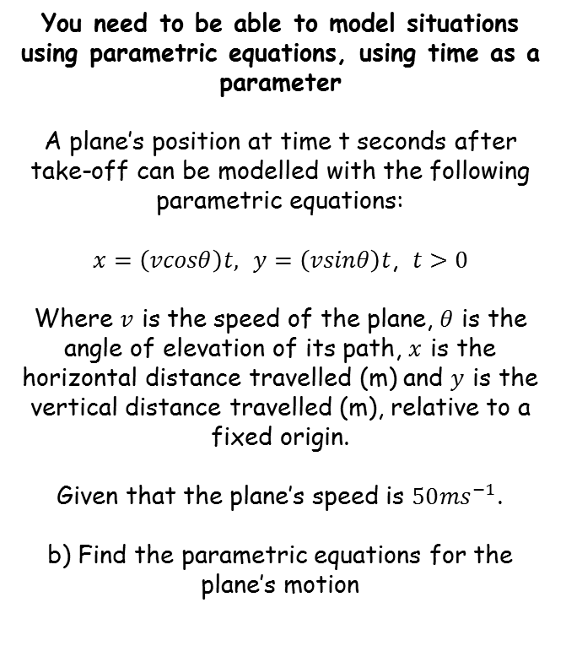





Parametric Equations
$$Angle of elevation=11.3^{°}$$
You need to be able to model situations using parametric equations, using time as a parameter
A plane’s position at time t seconds after take-off can be modelled with the following parametric equations:
$x=\left(vcosθ\right)t,$ $y=\left(vsinθ\right)t$, $t>0$
Where $v$ is the speed of the plane, $θ$ is the angle of elevation of its path, $x$ is the horizontal distance travelled (m) and $y$ is the vertical distance travelled (m), relative to a fixed origin.
Given that the plane’s speed is $50{ms}^{−1}$.
b) Find the parametric equations for the plane’s motion
$$120$$
$$θ$$
$$600$$
$$x=\left(vcosθ\right)t$$
Sub in $v=50$, as well as the exact value we calculated for $θ$
$$x=\left(50cos\left(11.3\right)\right)t$$
Calculate (this has been rounded to 3sf)
$$x=49.0t$$
$$y=\left(vsinθ\right)t$$
Sub in $v=50$, as well as the exact value we calculated for $θ$
$$y=\left(50sin\left(11.3\right)\right)t$$
Calculate (this has been rounded to 3sf)
$$y=9.81t$$
8E

Slide 39


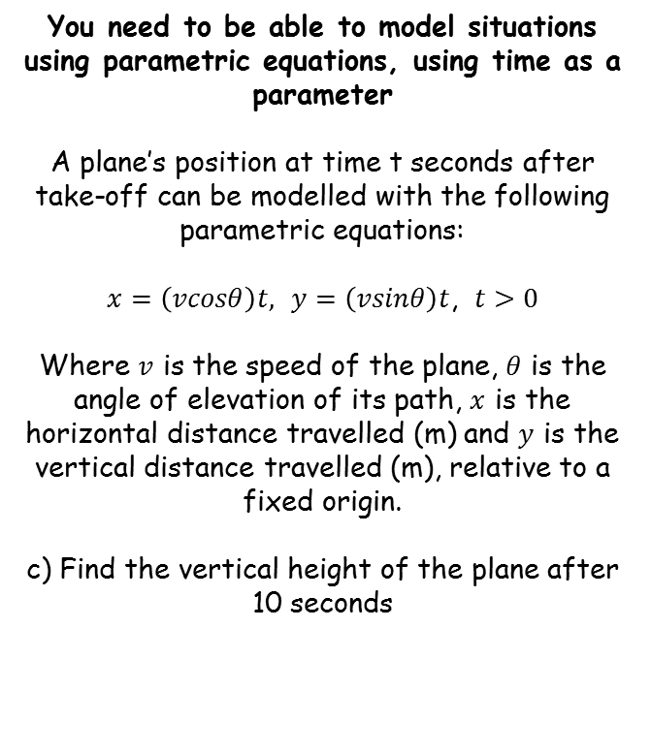




Parametric Equations
$$Angle of elevation=11.3^{°}$$
You need to be able to model situations using parametric equations, using time as a parameter
A plane’s position at time t seconds after take-off can be modelled with the following parametric equations:
$x=\left(vcosθ\right)t,$ $y=\left(vsinθ\right)t$, $t>0$
Where $v$ is the speed of the plane, $θ$ is the angle of elevation of its path, $x$ is the horizontal distance travelled (m) and $y$ is the vertical distance travelled (m), relative to a fixed origin.
c) Find the vertical height of the plane after 10 seconds
$$x=49.0t$$
$$y=9.80t$$
$$120$$
$$θ$$
$$600$$
$$y=9.80t$$
Sub in $t=10$
$$y=9.80(10)$$
Calculate
$$y=98m$$
→ The vertical height is represented by $y$
8E

Slide 40


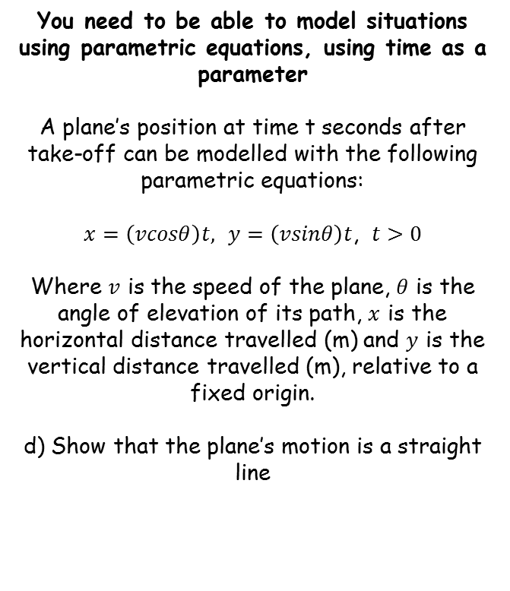
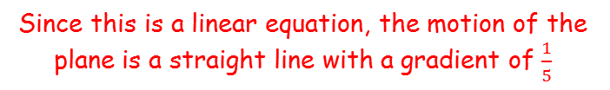



Parametric Equations
$$Angle of elevation=11.3^{°}$$
You need to be able to model situations using parametric equations, using time as a parameter
A plane’s position at time t seconds after take-off can be modelled with the following parametric equations:
$x=\left(vcosθ\right)t,$ $y=\left(vsinθ\right)t$, $t>0$
Where $v$ is the speed of the plane, $θ$ is the angle of elevation of its path, $x$ is the horizontal distance travelled (m) and $y$ is the vertical distance travelled (m), relative to a fixed origin.
d) Show that the plane’s motion is a straight line
$$x=49.0t$$
$$y=9.80t$$
$$120$$
$$θ$$
$$600$$
$$x=49.0t$$
Divide by 49.0
$$\frac{x}{49.0}=t$$
$$y=9.80t$$
Replace $t$ using the expression above
$$y=9.80\left(\frac{x}{49.0}\right)$$
Simplify
$$y=\frac{x}{5}$$
→ To do this, you should find an equation for the plane’s motion in Cartesian form, and show that it is linear
Since this is a linear equation, the motion of the plane is a straight line with a gradient of $\frac{1}{5}$
8E

Slide 41
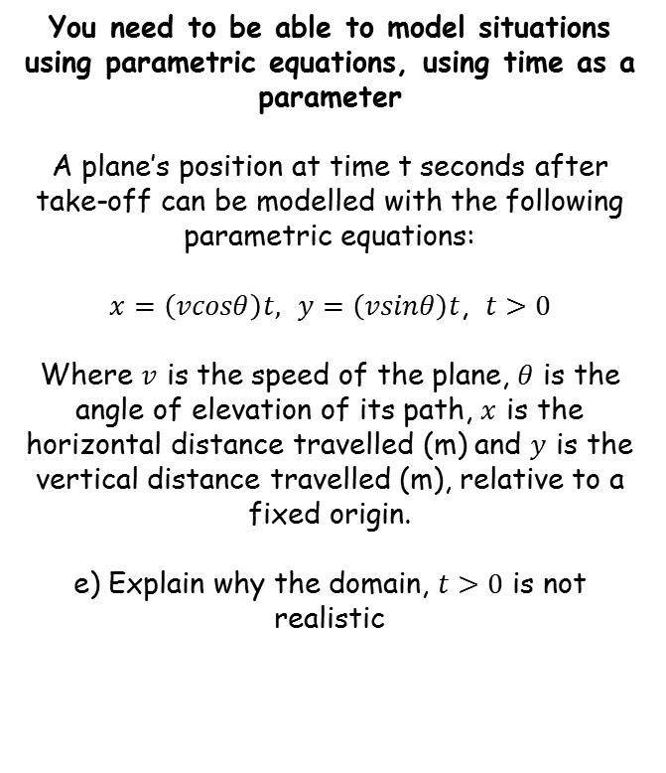
Parametric Equations
$$Angle of elevation=11.3^{°}$$
You need to be able to model situations using parametric equations, using time as a parameter
A plane’s position at time t seconds after take-off can be modelled with the following parametric equations:
$x=\left(vcosθ\right)t,$ $y=\left(vsinθ\right)t$, $t>0$
Where $v$ is the speed of the plane, $θ$ is the angle of elevation of its path, $x$ is the horizontal distance travelled (m) and $y$ is the vertical distance travelled (m), relative to a fixed origin.
e) Explain why the domain, $t>0$ is not realistic
$$x=49.0t$$
$$y=9.80t$$
$$120$$
$$θ$$
$$600$$
→ This would mean that the plane continues climbing indefinitely at the same speed and with the same elevation
8E

Slide 42



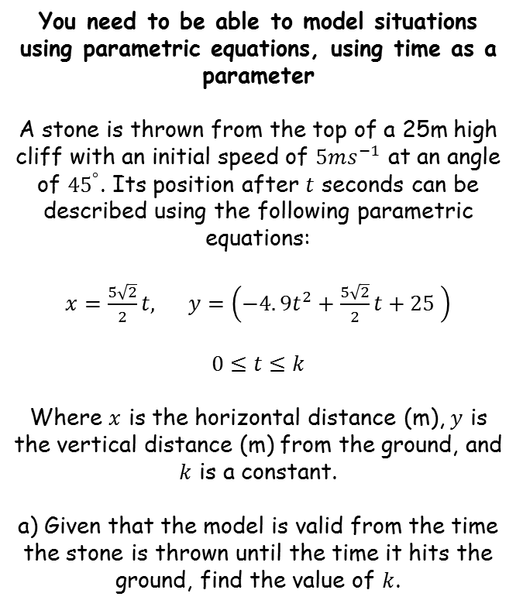





Parametric Equations
You need to be able to model situations using parametric equations, using time as a parameter
A stone is thrown from the top of a 25m high cliff with an initial speed of $5ms^{−1}$ at an angle of ${45}^{°}$. Its position after $t$ seconds can be described using the following parametric equations:
$x=\frac{5\sqrt{2}}{2}t,$ $y=\left(−4.{9t}^{2}+\frac{5\sqrt{2}}{2}t+25 \right)$
$$0≤t≤k$$
Where $x$ is the horizontal distance (m), $y$ is the vertical distance (m) from the ground, and $k$ is a constant.
a) Given that the model is valid from the time the stone is thrown until the time it hits the ground, find the value of $k$.
$${45}^{°}$$
$$25m$$
$$x$$
We want the stone’s height above the ground to be 0
Be careful – do not confuse this with a SUVAT question!
$$y=−4.{9t}^{2}+\frac{5\sqrt{2}}{2}t+25$$
Set the height above the ground equal to 0
$$0=−4.{9t}^{2}+\frac{5\sqrt{2}}{2}t+25$$
Summarise $a$, $b$ and $c$, and then we can use the quadratic formula…
$$b=\frac{5\sqrt{2}}{2}$$
The model is valid until the stone hits the ground, so we need to find out when this happens
$$a=−4.9$$
$$c=25$$
8E

Slide 43

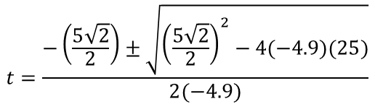





Parametric Equations
You need to be able to model situations using parametric equations, using time as a parameter
A stone is thrown from the top of a 25m high cliff with an initial speed of $5ms^{−1}$ at an angle of ${45}^{°}$. Its position after $t$ seconds can be described using the following parametric equations:
$x=\frac{5\sqrt{2}}{2}t,$ $y=\left(−4.{9t}^{2}+\frac{5\sqrt{2}}{2}t+25 \right)$
$$0≤t≤k$$
Where $x$ is the horizontal distance (m), $y$ is the vertical distance (m) from the ground, and $k$ is a constant.
a) Given that the model is valid from the time the stone is thrown until the time it hits the ground, find the value of $k$.
$${45}^{°}$$
$$25m$$
$$x$$
$$b=\frac{5\sqrt{2}}{2}$$
$$a=−4.9$$
$$c=25$$
$$t=\frac{−b±\sqrt{b^{2}−4ac}}{2a}$$
$$t=\frac{−\left(\frac{5\sqrt{2}}{2}\right)±\sqrt{{\left(\frac{5\sqrt{2}}{2}\right)}^{2}−4(−4.9)(25)}}{2(−4.9)}$$
Sub in values
Use your calculator!
$t=−1.92$ or $2.648$
The value of $t$ must be positive
8E

Slide 44


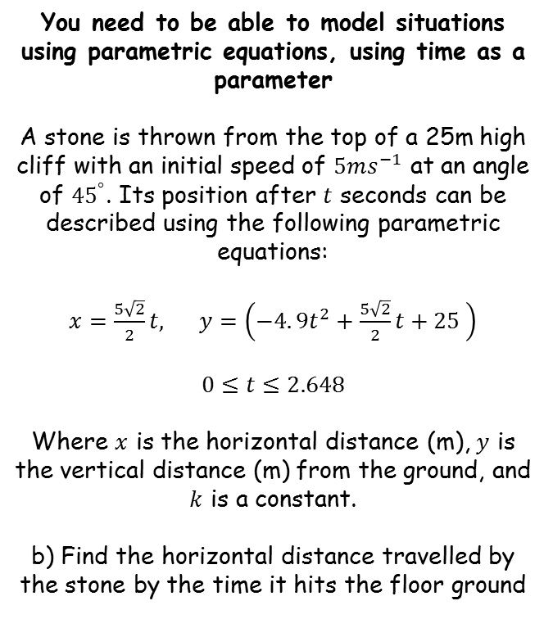


Parametric Equations
You need to be able to model situations using parametric equations, using time as a parameter
A stone is thrown from the top of a 25m high cliff with an initial speed of $5ms^{−1}$ at an angle of ${45}^{°}$. Its position after $t$ seconds can be described using the following parametric equations:
$x=\frac{5\sqrt{2}}{2}t,$ $y=\left(−4.{9t}^{2}+\frac{5\sqrt{2}}{2}t+25 \right)$
$$0≤t≤2.648$$
Where $x$ is the horizontal distance (m), $y$ is the vertical distance (m) from the ground, and $k$ is a constant.
b) Find the horizontal distance travelled by the stone by the time it hits the floor ground
$${45}^{°}$$
$$25m$$
$$x$$
$$x=\frac{5\sqrt{2}}{2}t$$
Sub in the value of $t$ when the stone hits the floor
$$x=\frac{5\sqrt{2}}{2}(2.648)$$
Calculate
$$x=9.36$$
8E

Slide 45
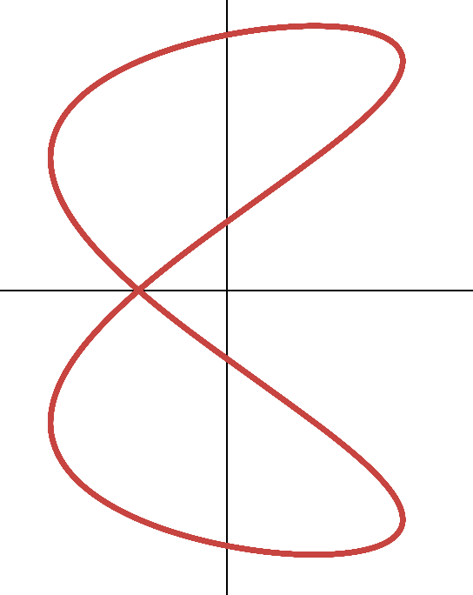





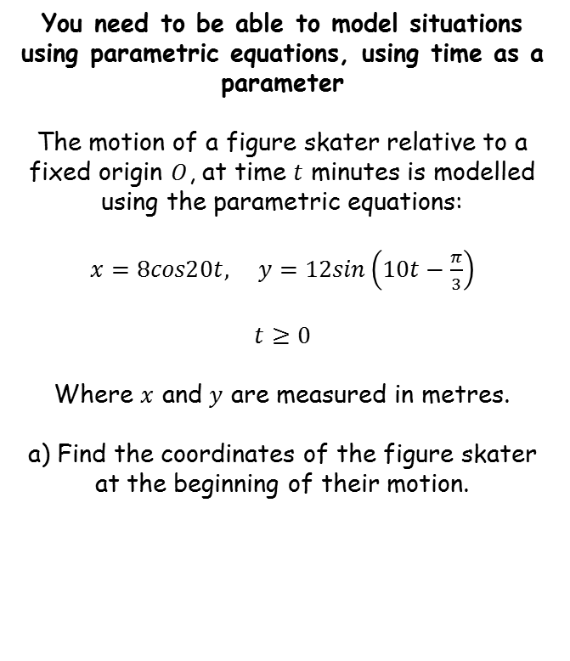







Parametric Equations
$$y$$
$$x=8cos20t$$
$$y=12sin\left(10t−\frac{π}{3}\right)$$
You need to be able to model situations using parametric equations, using time as a parameter
The motion of a figure skater relative to a fixed origin $O$, at time $t$ minutes is modelled using the parametric equations:
$x=8cos20t,$ $y=12sin\left(10t−\frac{π}{3}\right)$
$$t≥0$$
Where $x$ and $y$ are measured in metres.
a) Find the coordinates of the figure skater at the beginning of their motion.
$$x$$
$$x=8cos20t$$
$$y=12sin\left(10t−\frac{π}{3}\right)$$
Sub in $t=0$
Sub in $t=0$
$$x=8cos20(0)$$
$$y=12sin\left(10(0)−\frac{π}{3}\right)$$
At the beginning of their motion, $t=0$
Work out
Work out
$$x=8$$
$$y=−6\sqrt{3}$$
So the coordinates would be $\left(8,−6\sqrt{3}\right)$
8E

Slide 46


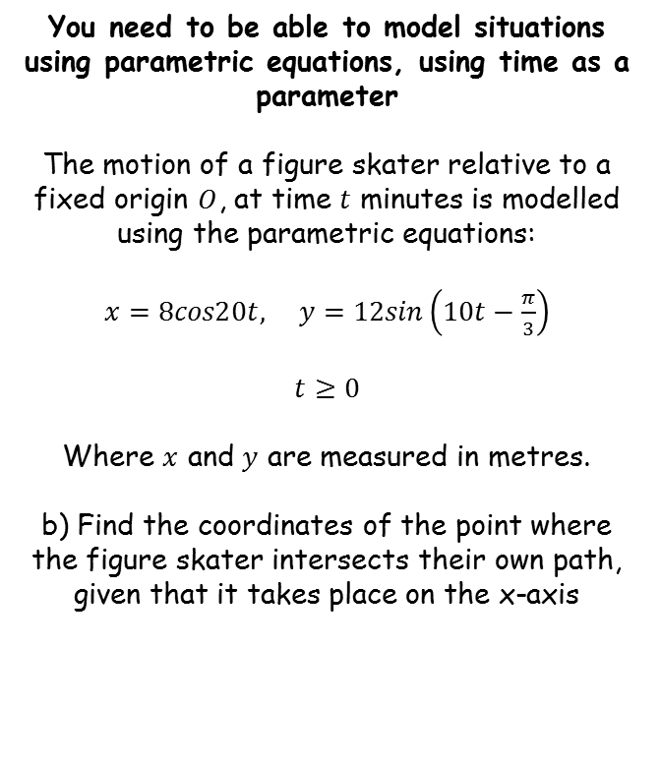

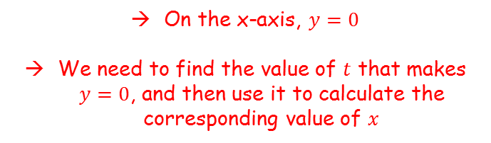


Parametric Equations
$$y$$
$$x=8cos20t$$
$$y=12sin\left(10t−\frac{π}{3}\right)$$
You need to be able to model situations using parametric equations, using time as a parameter
The motion of a figure skater relative to a fixed origin $O$, at time $t$ minutes is modelled using the parametric equations:
$x=8cos20t,$ $y=12sin\left(10t−\frac{π}{3}\right)$
$$t≥0$$
Where $x$ and $y$ are measured in metres.
b) Find the coordinates of the point where the figure skater intersects their own path, given that it takes place on the x-axis
$$x$$
$$y=12sin\left(10t−\frac{π}{3}\right)$$
Set $y=0$
$$0=12sin\left(10t−\frac{π}{3}\right)$$
On the x-axis, $y=0$
We need to find the value of $t$ that makes $y=0$, and then use it to calculate the corresponding value of $x$
Divide by 12
$$0=sin\left(10t−\frac{π}{3}\right)$$
$$0=10t−\frac{π}{3}$$
Inverse sine
8E

Slide 47
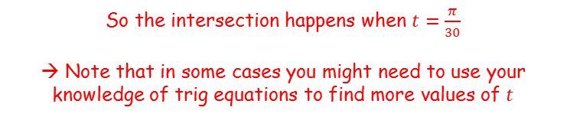




Parametric Equations
$$y$$
$$x=8cos20t$$
$$y=12sin\left(10t−\frac{π}{3}\right)$$
You need to be able to model situations using parametric equations, using time as a parameter
The motion of a figure skater relative to a fixed origin $O$, at time $t$ minutes is modelled using the parametric equations:
$x=8cos20t,$ $y=12sin\left(10t−\frac{π}{3}\right)$
$$t≥0$$
Where $x$ and $y$ are measured in metres.
b) Find the coordinates of the point where the figure skater intersects their own path, given that it takes place on the x-axis
$$x$$
$$0=10t−\frac{π}{3}$$
Add $\frac{π}{3}$
$$\frac{π}{3}=10t$$
Divide by 10
On the x-axis, $y=0$
We need to find the value of $t$ that makes $y=0$, and then use it to calculate the corresponding value of $x$
$$\frac{π}{30}=t$$
So the intersection happens when $t=\frac{π}{30}$
→ Note that in some cases you might need to use your knowledge of trig equations to find more values of $t$
8E

Slide 48





Parametric Equations
$$y$$
$$x=8cos20t$$
$$y=12sin\left(10t−\frac{π}{3}\right)$$
You need to be able to model situations using parametric equations, using time as a parameter
The motion of a figure skater relative to a fixed origin $O$, at time $t$ minutes is modelled using the parametric equations:
$x=8cos20t,$ $y=12sin\left(10t−\frac{π}{3}\right)$
$$t≥0$$
Where $x$ and $y$ are measured in metres.
b) Find the coordinates of the point where the figure skater intersects their own path, given that it takes place on the x-axis
$$x$$
$$x=8cos20t$$
Sub in $t=\frac{π}{30}$
$$x=8cos20\left(\frac{π}{30}\right)$$
On the x-axis, $y=0$
We need to find the value of $t$ that makes $y=0$, and then use it to calculate the corresponding value of $x$
Calculate
$$x=−4$$
So the coordinates would be $\left(−4,0\right)$
8E

Slide 49
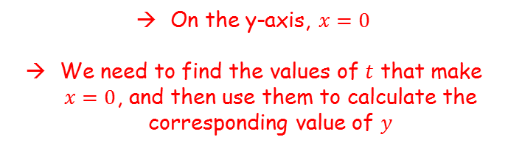



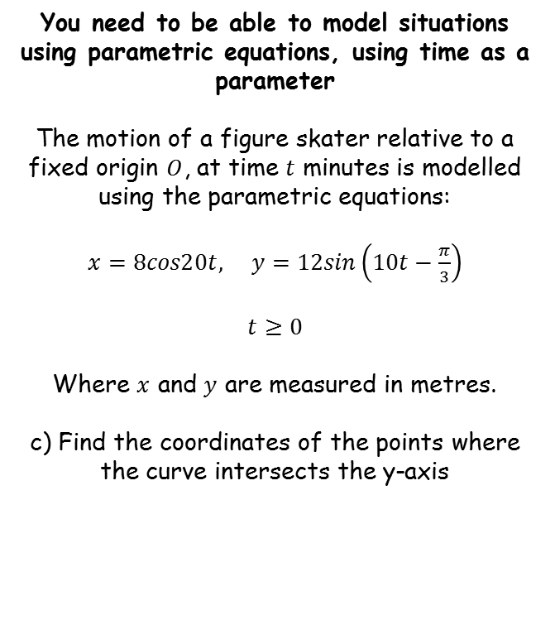





Parametric Equations
$$y$$
$$x=8cos20t$$
$$y=12sin\left(10t−\frac{π}{3}\right)$$
You need to be able to model situations using parametric equations, using time as a parameter
The motion of a figure skater relative to a fixed origin $O$, at time $t$ minutes is modelled using the parametric equations:
$x=8cos20t,$ $y=12sin\left(10t−\frac{π}{3}\right)$
$$t≥0$$
Where $x$ and $y$ are measured in metres.
c) Find the coordinates of the points where the curve intersects the y-axis
$$x$$
$$x=8cos20t$$
Sub in $x=0$
$$0=8cos20t$$
Divide by 8
$$0=cos20t$$
On the y-axis, $x=0$
We need to find the values of $t$ that make $x=0$, and then use them to calculate the corresponding value of $y$
Inverse cos
$$\frac{π}{2}=20t$$
Remember to find other possible values (you will need 4 as there are 4 intersections with the y-axis)
$$20t=\frac{π}{2}$$
$$, \frac{3π}{2}$$
$$, \frac{5π}{2}$$
$$, \frac{7π}{2}$$
8E

Slide 50





Parametric Equations
$$y$$
$$x=8cos20t$$
$$y=12sin\left(10t−\frac{π}{3}\right)$$
You need to be able to model situations using parametric equations, using time as a parameter
The motion of a figure skater relative to a fixed origin $O$, at time $t$ minutes is modelled using the parametric equations:
$x=8cos20t,$ $y=12sin\left(10t−\frac{π}{3}\right)$
$$t≥0$$
Where $x$ and $y$ are measured in metres.
c) Find the coordinates of the points where the curve intersects the y-axis
$$x$$
$$20t=\frac{π}{2}$$
$$, \frac{3π}{2}$$
$$, \frac{5π}{2}$$
$$, \frac{7π}{2}$$
Divide all by 20
$$t=\frac{π}{40}$$
$$, \frac{3π}{40}$$
$$, \frac{5π}{40}$$
$$, \frac{7π}{40}$$
On the y-axis, $x=0$
We need to find the values of $t$ that make $x=0$, and then use them to calculate the corresponding value of $y$
8E

Slide 51













Parametric Equations
$$y$$
$$x=8cos20t$$
11.59
$$y=12sin\left(10t−\frac{π}{3}\right)$$
You need to be able to model situations using parametric equations, using time as a parameter
The motion of a figure skater relative to a fixed origin $O$, at time $t$ minutes is modelled using the parametric equations:
$x=8cos20t,$ $y=12sin\left(10t−\frac{π}{3}\right)$
$$t≥0$$
Where $x$ and $y$ are measured in metres.
c) Find the coordinates of the points where the curve intersects the y-axis
3.11
$$x$$
-3.11
$$t=\frac{π}{40}$$
$$, \frac{3π}{40}$$
$$, \frac{5π}{40}$$
$$, \frac{7π}{40}$$
-11.59
$$y=12sin\left(10\left(\frac{π}{40}\right)−\frac{π}{3}\right)$$
$$y=12sin\left(10\left(\frac{3π}{40}\right)−\frac{π}{3}\right)$$
$$t=\frac{3π}{40}$$
$$y=−3.11$$
$$t=\frac{π}{40}$$
$$y=11.59$$
$$y=12sin\left(10t−\frac{π}{3}\right)$$
On the y-axis, $x=0$
We need to find the values of $t$ that make $x=0$, and then use them to calculate the corresponding value of $y$
$$t=\frac{5π}{40}$$
$$t=\frac{7π}{40}$$
$$y=12sin\left(10\left(\frac{5π}{40}\right)−\frac{π}{3}\right)$$
$$y=12sin\left(10\left(\frac{7π}{40}\right)−\frac{π}{3}\right)$$
$$y=3.11$$
$$y=−11.59$$
8E

Slide 52
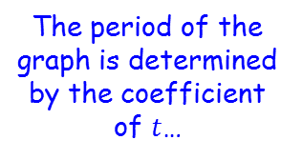





Parametric Equations
$$y$$
$$x=8cos20t$$
$$y=12sin\left(10t−\frac{π}{3}\right)$$
You need to be able to model situations using parametric equations, using time as a parameter
The motion of a figure skater relative to a fixed origin $O$, at time $t$ minutes is modelled using the parametric equations:
$x=8cos20t,$ $y=12sin\left(10t−\frac{π}{3}\right)$
$$t≥0$$
Where $x$ and $y$ are measured in metres.
d) Find how long it takes the figure skater to complete one figure of eight motion
The period of the graph is determined by the coefficient of $t$…
$$x$$
The graph of cos has a period of $2π$, so the skater would return to their original x-position every $2π$ minutes
$$x=cost$$
The skater will have completed a full figure 8 when both his x and y coordinates are in their original position
It is possible that the x-coordinate will return to its starting position, but with the y-coordinate being different…
This graph of cos has a period of $\frac{2π}{20}$, so the skater would return to their original x-position every $\frac{2π}{20}$ minutes
$$x=8cos20t$$
Original $x$ position at: $\frac{2π}{20}, \frac{4π}{20}, \frac{6π}{20}, \frac{8π}{20}, \frac{10π}{20}…$
8E

Slide 53







Parametric Equations
$$y$$
$$x=8cos20t$$
$$y=12sin\left(10t−\frac{π}{3}\right)$$
You need to be able to model situations using parametric equations, using time as a parameter
The motion of a figure skater relative to a fixed origin $O$, at time $t$ minutes is modelled using the parametric equations:
$x=8cos20t,$ $y=12sin\left(10t−\frac{π}{3}\right)$
$$t≥0$$
Where $x$ and $y$ are measured in metres.
d) Find how long it takes the figure skater to complete one figure of eight motion
Original $x$ position at: $\frac{2π}{20}, \frac{4π}{20}, \frac{6π}{20}, \frac{8π}{20}, \frac{10π}{20}…$
$$x$$
The period of the graph is determined by the coefficient of $t$…
The graph of sin has a period of $2π$, so the skater would return to his original y-position every $2π$ minutes
$$y=sint$$
The skater will have completed a full figure 8 when both his x and y coordinates are in their original position
It is possible that the x-coordinate will return to its starting position, but with the y-coordinate being different…
This graph of sin has a period of $\frac{2π}{10}$, so the skater would return to his original y-position every $\frac{2π}{10}$ minutes
$$y=12sin\left(10t−\frac{π}{3}\right)$$
Original $y$ position at: $\frac{2π}{10}, \frac{4π}{10}, \frac{6π}{10}, \frac{8π}{10}, \frac{10π}{10}…$
8E

Slide 54





Parametric Equations
$$y$$
$$x=8cos20t$$
$$y=12sin\left(10t−\frac{π}{3}\right)$$
You need to be able to model situations using parametric equations, using time as a parameter
The motion of a figure skater relative to a fixed origin $O$, at time $t$ minutes is modelled using the parametric equations:
$x=8cos20t,$ $y=12sin\left(10t−\frac{π}{3}\right)$
$$t≥0$$
Where $x$ and $y$ are measured in metres.
d) Find how long it takes the figure skater to complete one figure of eight motion
Original $x$ position at: $\frac{2π}{20}, \frac{4π}{20}, \frac{6π}{20}, \frac{8π}{20}, \frac{10π}{20}…$
$$x$$
Original $y$ position at: $\frac{2π}{10}, \frac{4π}{10}, \frac{6π}{10}, \frac{8π}{10}, \frac{10π}{10}…$
The skater will have completed a full figure 8 when both his x and y coordinates are in their original position
Find the lowest common multiple of the periods of x and y (be careful with equivalent fractions!)
So one figure-eight takes $\frac{2π}{10}$ minutes
$$\frac{2π}{10} minutes$$
$$=0.628 minutes$$
$$=38 seconds$$
8E

